Slide 1

Regression Analysis Interpretation October 7, 2025
Wenhui (Vivian) Zhang, PhD, MS (Statistics),
Research Assistant Professor,
Nell Hodgson Woodruff School of Nursing, Emory University
Notes:
Gelman A. Rindskopf’s Rules for Statistical Consulting. [Internet]. 2008 [cited 2024 July 10]. Available from: https://statmodeling.stat.columbia.edu/2008/01/25/rindskopfs_rule/

Slide 2
Overview
Correlation
Linear Regression
Logistic Regression
Survival Analysis: Cox Regression
Lab Session
Q&A

Slide 3
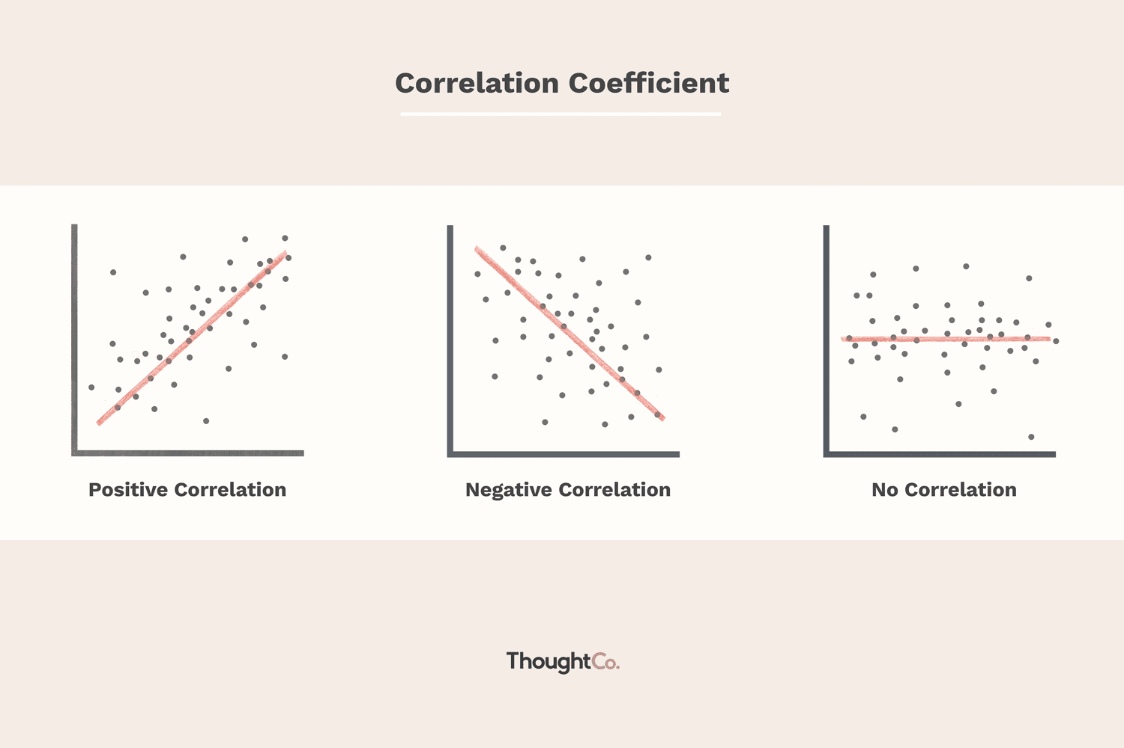
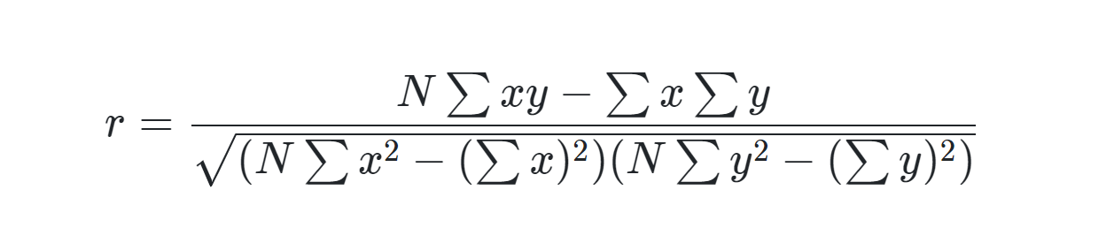
Correlation
Question: Are A and B related/associated?
What’s the direction/degree of the linear relationship?
Hypothesis: H0: r = 0; H1: r ≠ 0
Assumptions:
Level of measurement, related pairs, absence of outliers, and linearity
Pearson's correlation: interval/ratio
Spearman’s correlation: ordinal
3

Slide 4
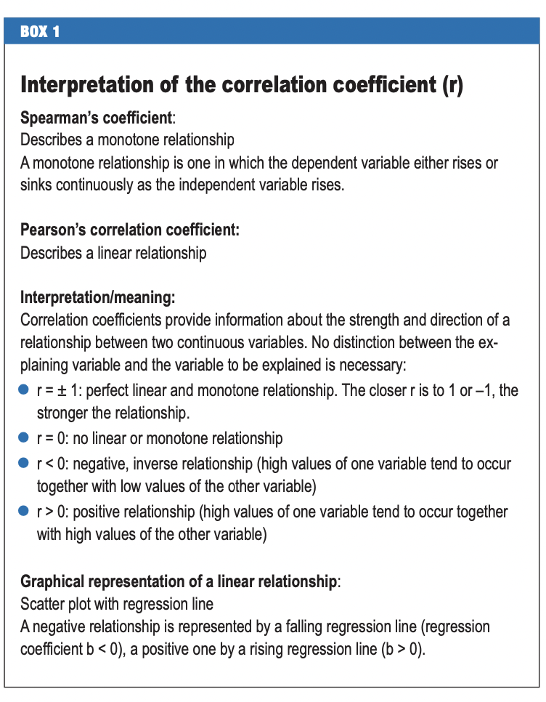
Correlation Coefficient
Effect size small, medium, large
T-test: Cohen’s d, 0.2, 0.5, 0.8
Pearson’s correlation r: 0.1, 0.3, 0.5
Relative risk, odds ratio…
Notes:
Schneider A, Hommel G, Blettner M: Linear regression analysis—part 14 of a series on evaluation of scientific publications. Dtsch Arztebl Int 2010; 107(44): 776–82. DOI: 10.3238/arztebl.2010.0776

Slide 5
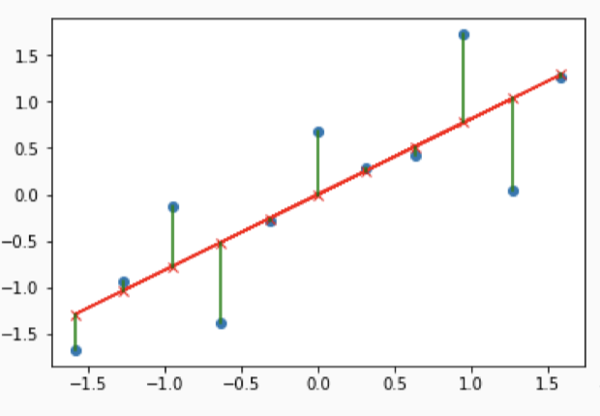
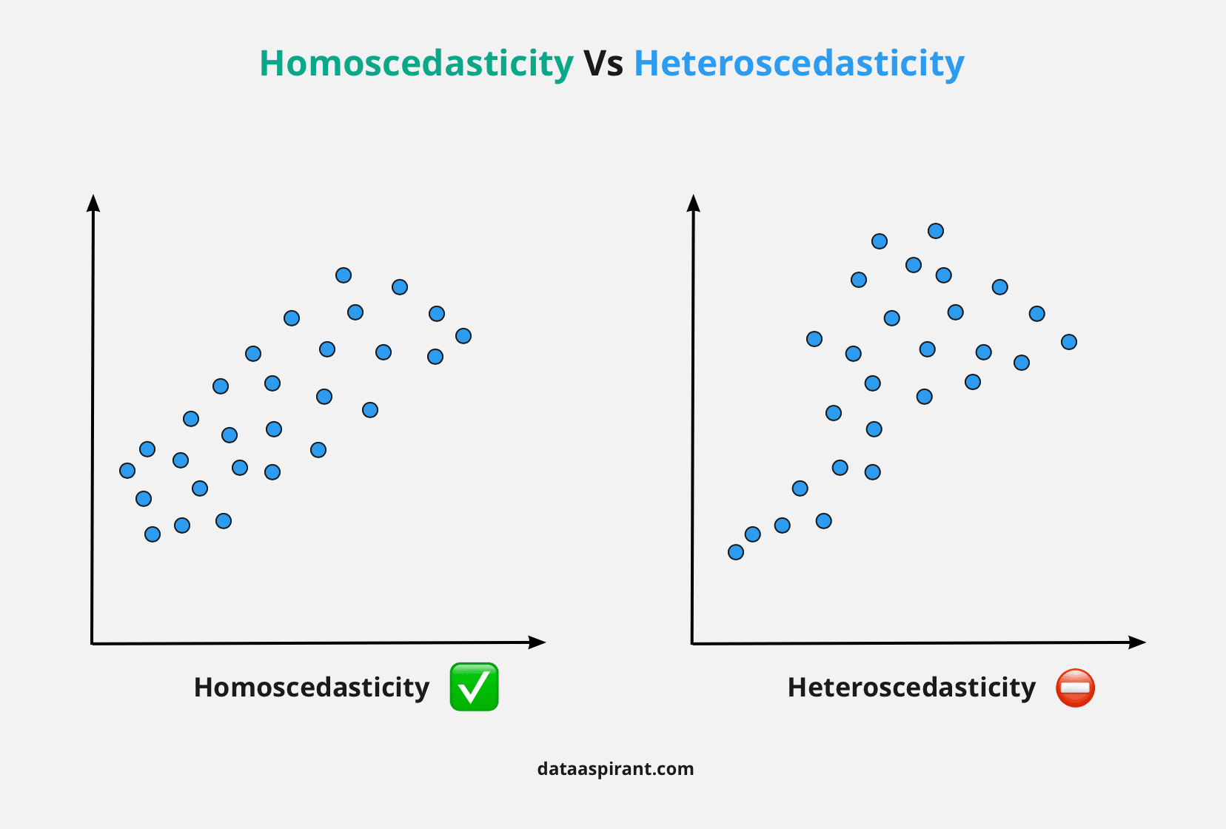
Regression
Question: Predict Y with X (X1, X2…), dependent/independent variable?
Description, estimation, prognostication
Simple Linear Regression: y=bx+ a+ error (b: slope, a: intercept)
Logistic Regression: log odds=a +bx +error
Others: Multiple linear regression, general linear model, Poisson, non-linear…
Hypothesis: H0: b=0; H1: b≠0
R square, F-test, t-test of coefficients
Assumptions: Simple linear regression
Independence of observations
Level of measurement, continuous (y)
Normal distribution (y)
Linear relationship
Homoscedasticity
Residuals are normally distributed
5

Slide 6
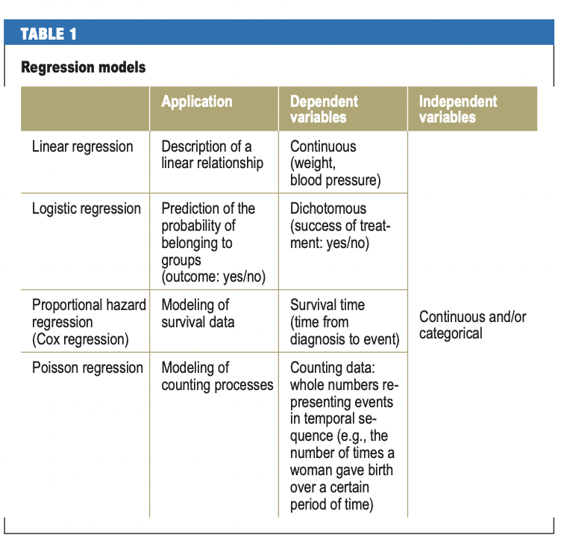
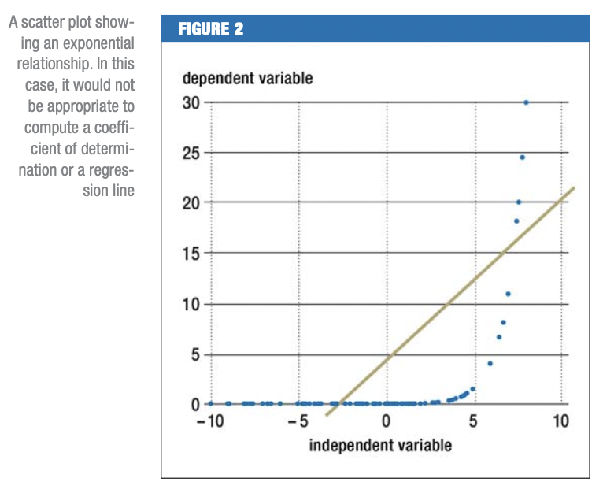
Regression
Simple, Multiple linear regression
Logistic regression
Binary, multinomial, ordinal
Curvilinear
Non-linear
Poisson regression
General linear model
Generalized linear model
Cox regression
Notes:
Schneider A, Hommel G, Blettner M: Linear regression analysis—part 14 of a series on evaluation of scientific publications. Dtsch Arztebl Int 2010; 107(44): 776–82. DOI: 10.3238/arztebl.2010.0776
https://online.stat.psu.edu/stat504/lesson/6/6.1

Slide 7
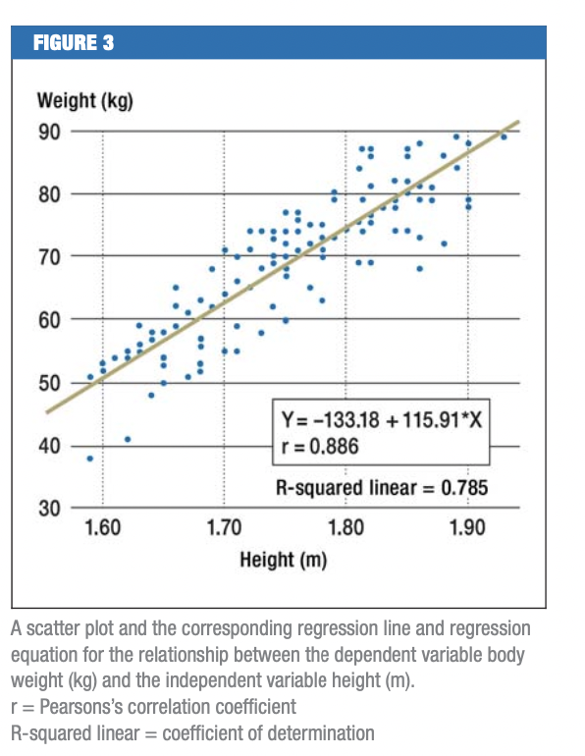
Linear Regression
Univariate, multivariate (confounding)
y=bx+ a+ error (b: slope, a: intercept)
y=b1x1+b2x2+…+bnxn+a+error
Regression coefficient (b), b=0 (t-test)
Unit measure, categorical reference
R square: coefficient of determination
Variance explained by Xs or the model
Adjusted R square (n)
Number of observations >20*n(variables)
Notes:
Schneider A, Hommel G, Blettner M: Linear regression analysis—part 14 of a series on evaluation of scientific publications. Dtsch Arztebl Int 2010; 107(44): 776–82. DOI: 10.3238/arztebl.2010.0776

Slide 8
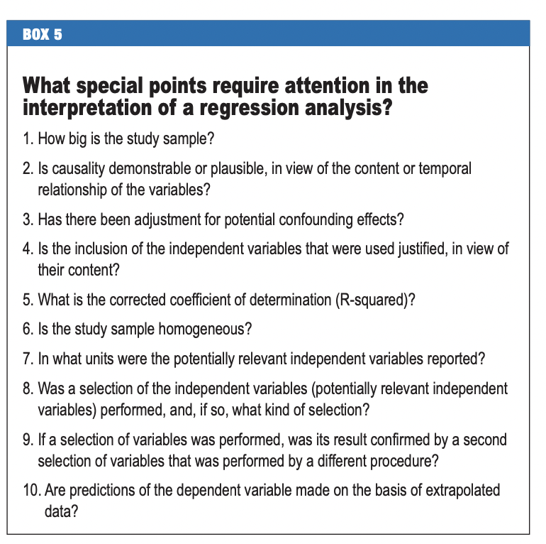
Linear Regression
Variable selection:
Forward
Backward
Stepwise
Block inclusion
Causality
Sample size
Missing value
Data sample: subgroup analysis
Notes:
Schneider A, Hommel G, Blettner M: Linear regression analysis—part 14 of a series on evaluation of scientific publications. Dtsch Arztebl Int 2010; 107(44): 776–82. DOI: 10.3238/arztebl.2010.0776

Slide 9
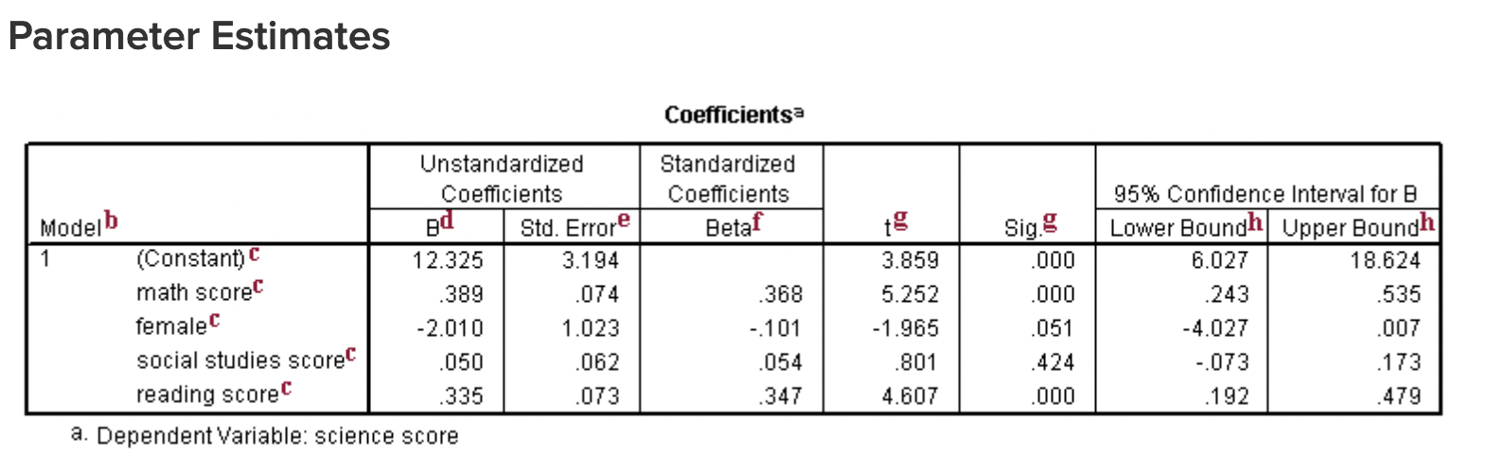
Linear Regression

Slide 10
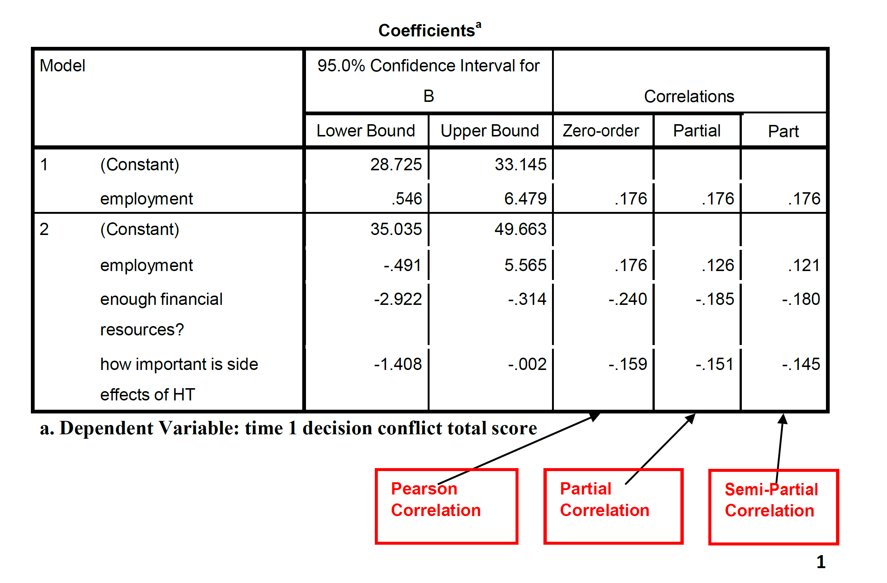
10

Slide 11
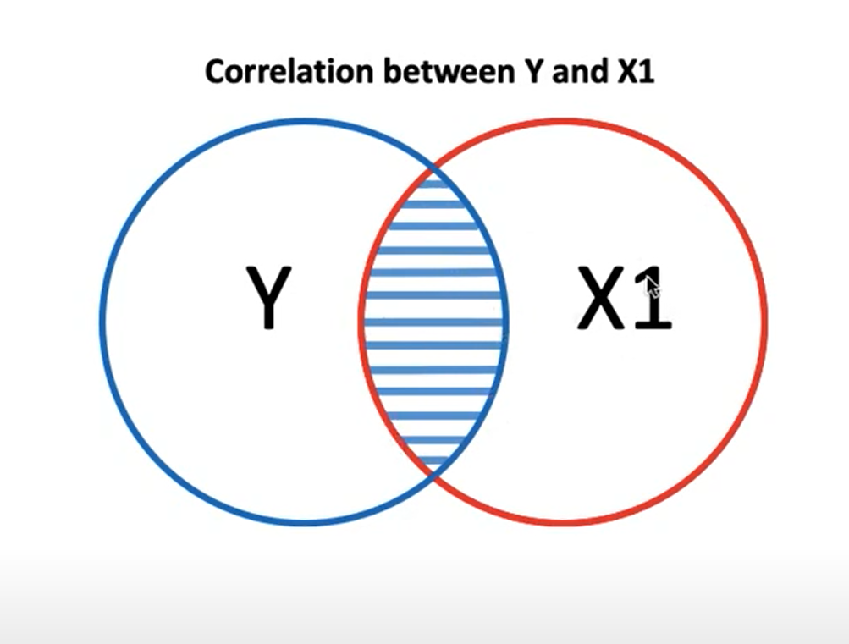
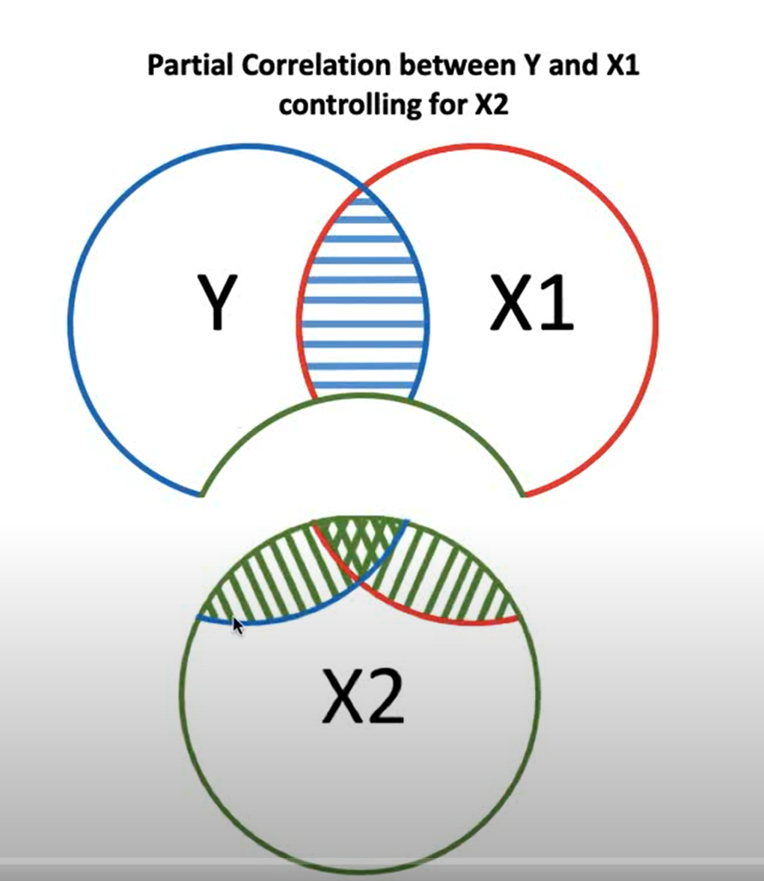
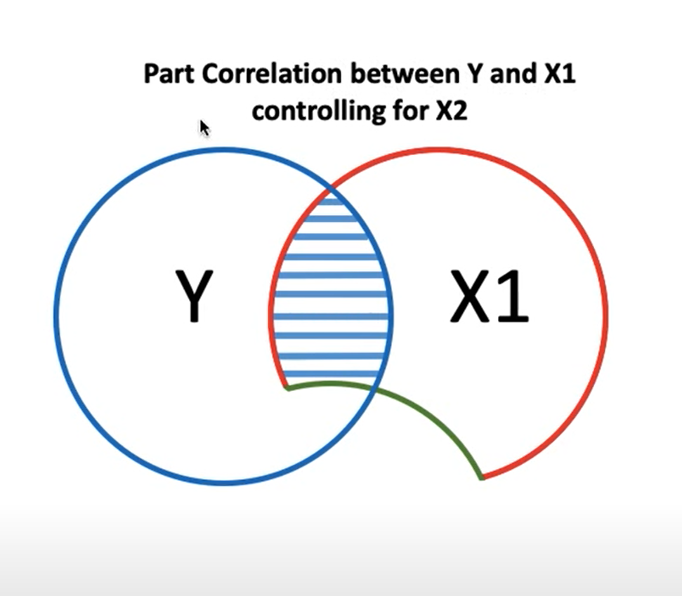
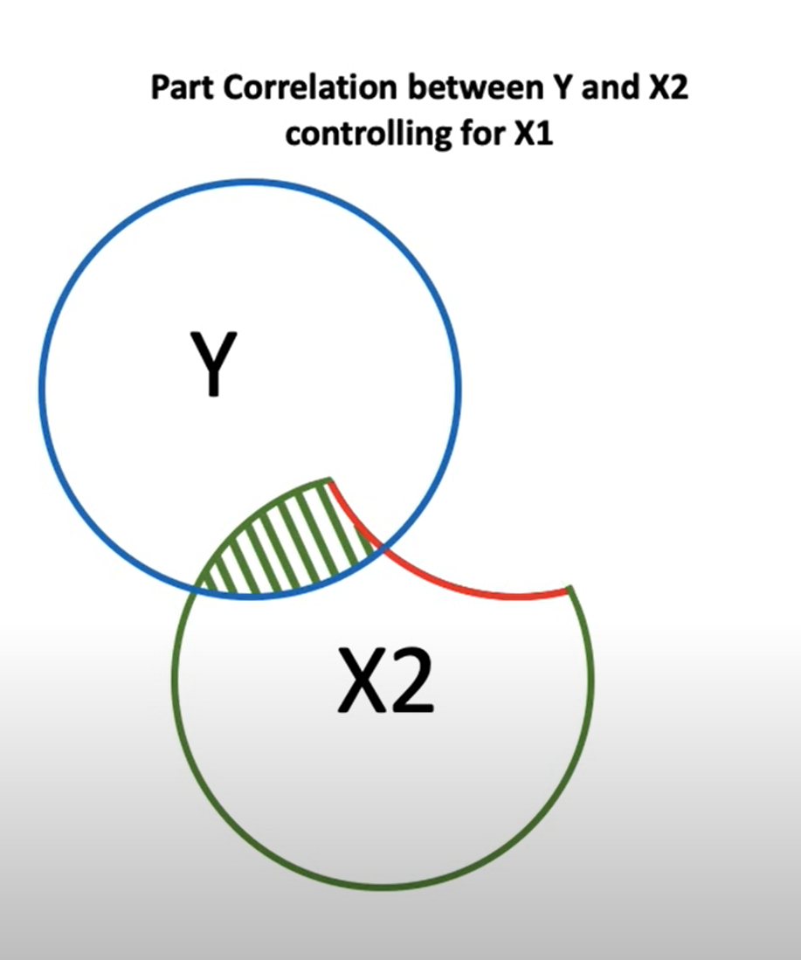
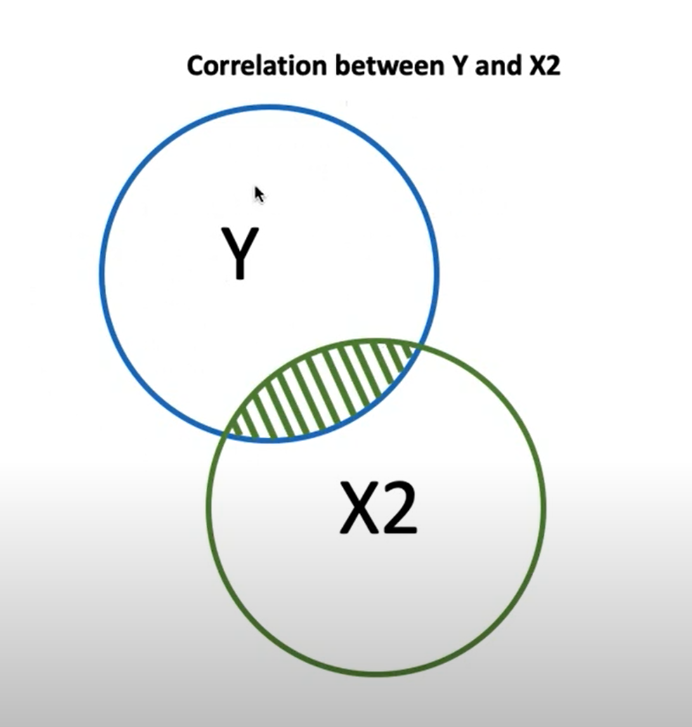
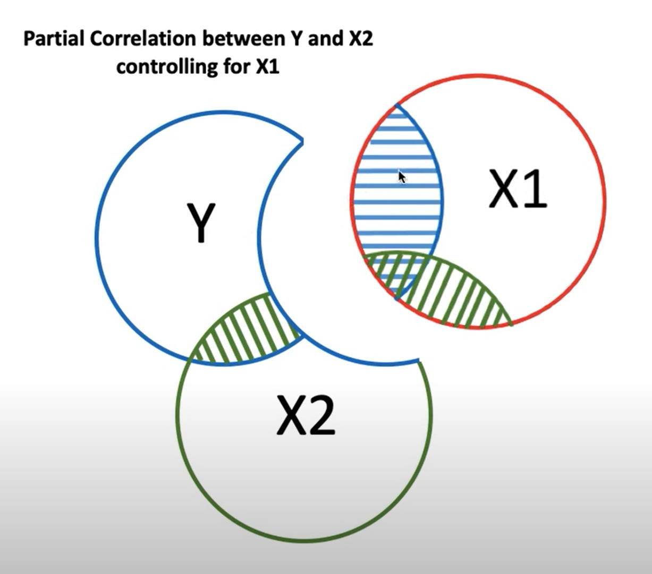
11

Slide 12
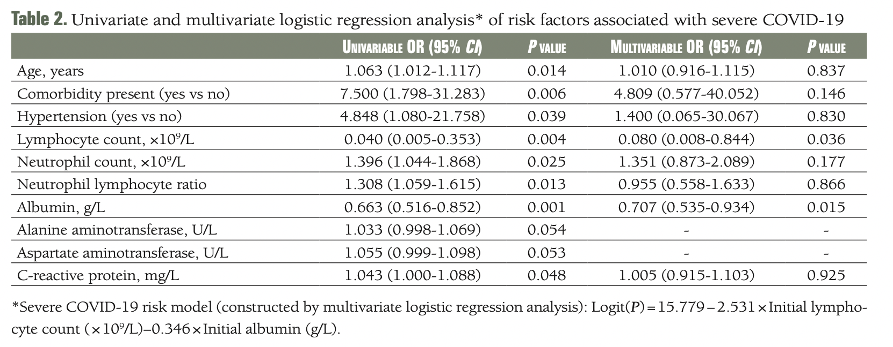
Logistic Regression
Notes:
Hu H, Du H, Li J, Wang Y, Wu X, Wang C, Zhang Y, Zhang G, Zhao Y, Kang W, Lian J. Early prediction and identification for severe patients during the pandemic of COVID-19: A severe COVID-19 risk model constructed by multivariate logistic regression analysis. J Glob Health. 2020 Dec;10(2):020510. doi: 10.7189/jogh.10.020510. PMID: 33110593; PMCID: PMC7567445.

Slide 13
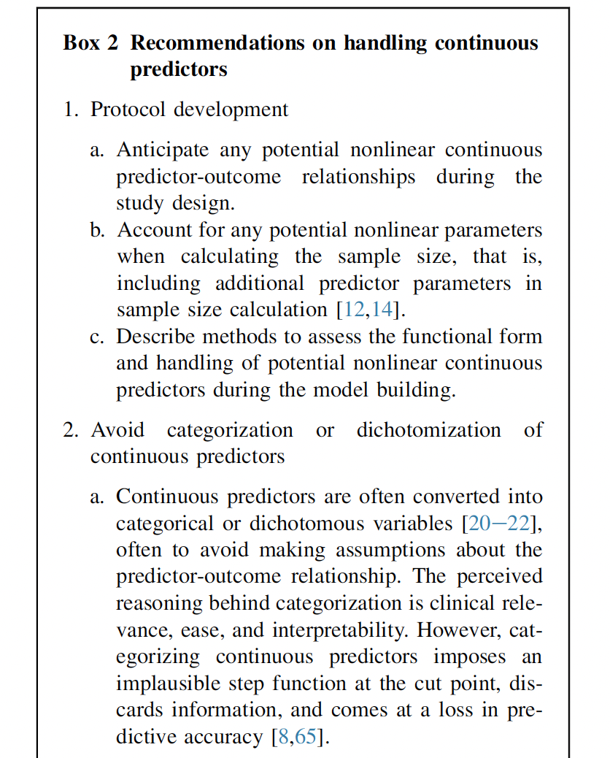
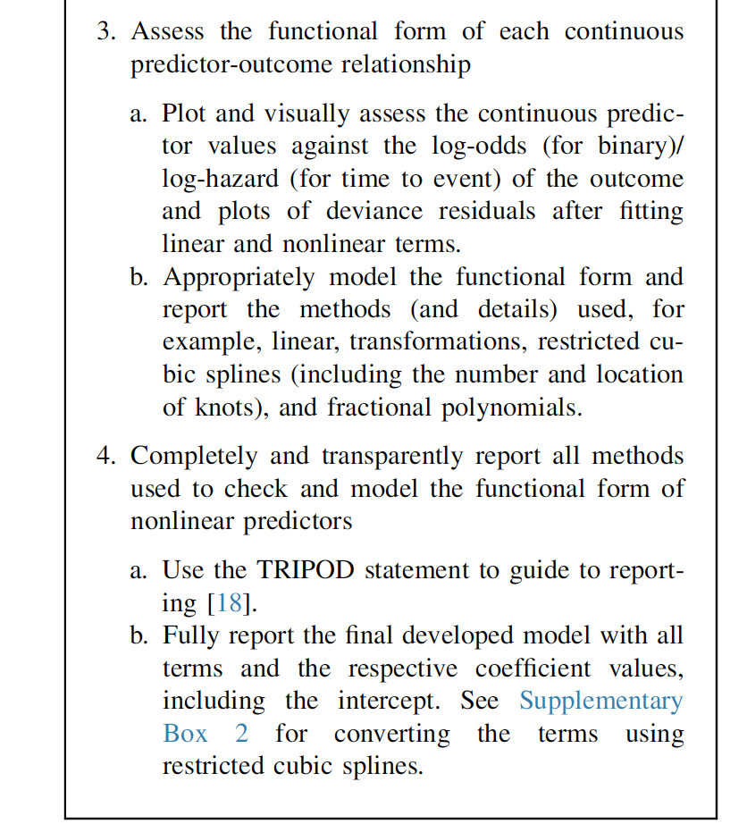
How to handle continuous predictors?
Notes:
Ma J, Dhiman P, Qi C, Bullock G, van Smeden M, Riley RD, Collins GS. Poor handling of continuous predictors in clinical prediction models using logistic regression: a systematic review. J Clin Epidemiol. 2023 Sep;161:140-151. doi: 10.1016/j.jclinepi.2023.07.017. Epub 2023 Aug 2. PMID: 37536504. https://pubmed.ncbi.nlm.nih.gov/37536504/

Slide 14
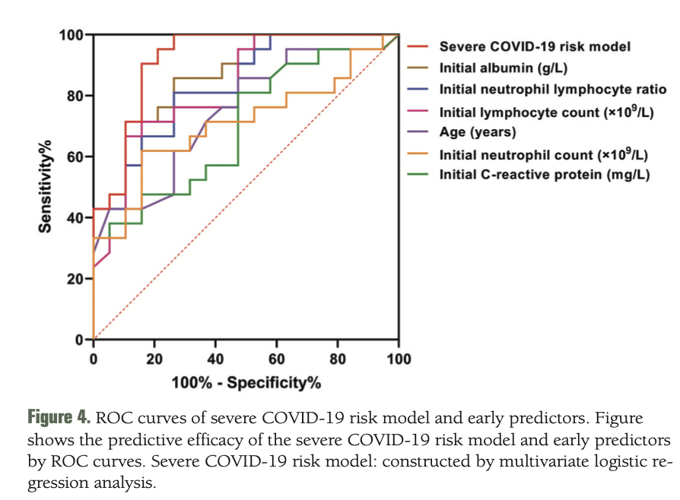
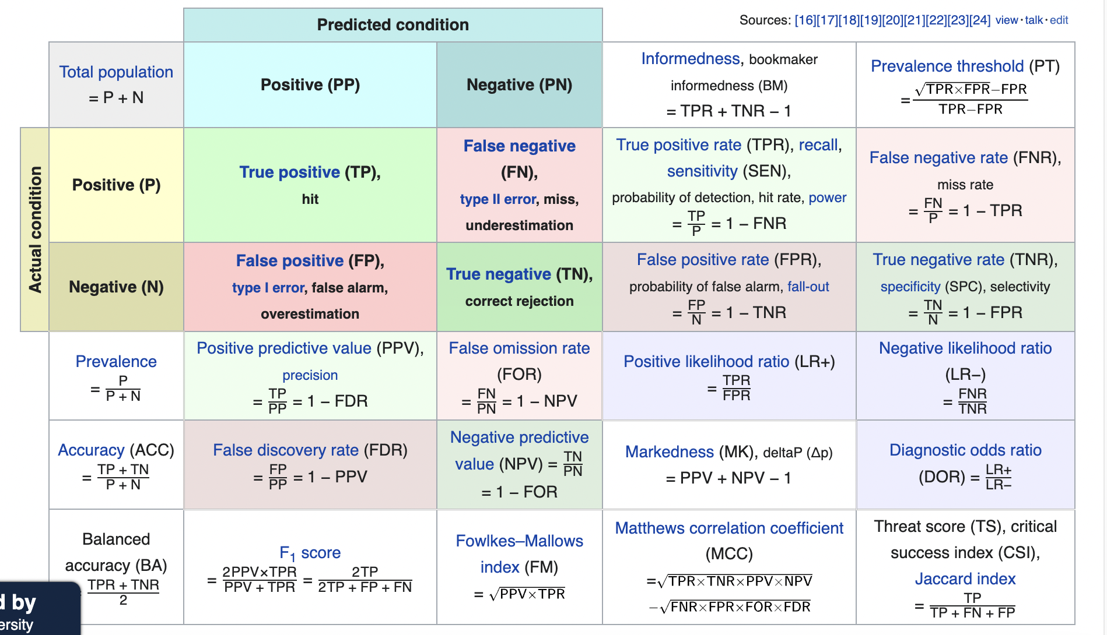
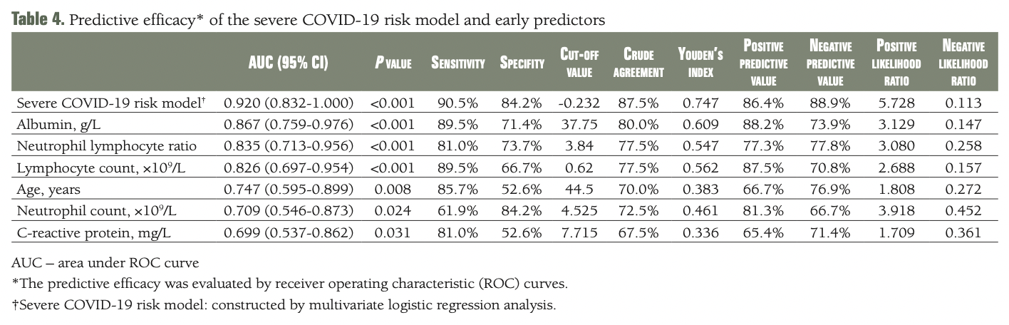
ROC curve
Sensitivity
Specificity
Notes:
Hu H, Du H, Li J, Wang Y, Wu X, Wang C, Zhang Y, Zhang G, Zhao Y, Kang W, Lian J. Early prediction and identification for severe patients during the pandemic of COVID-19: A severe COVID-19 risk model constructed by multivariate logistic regression analysis. J Glob Health. 2020 Dec;10(2):020510. doi: 10.7189/jogh.10.020510. PMID: 33110593; PMCID: PMC7567445.
https://en.wikipedia.org/wiki/Receiver_operating_characteristic

Slide 15
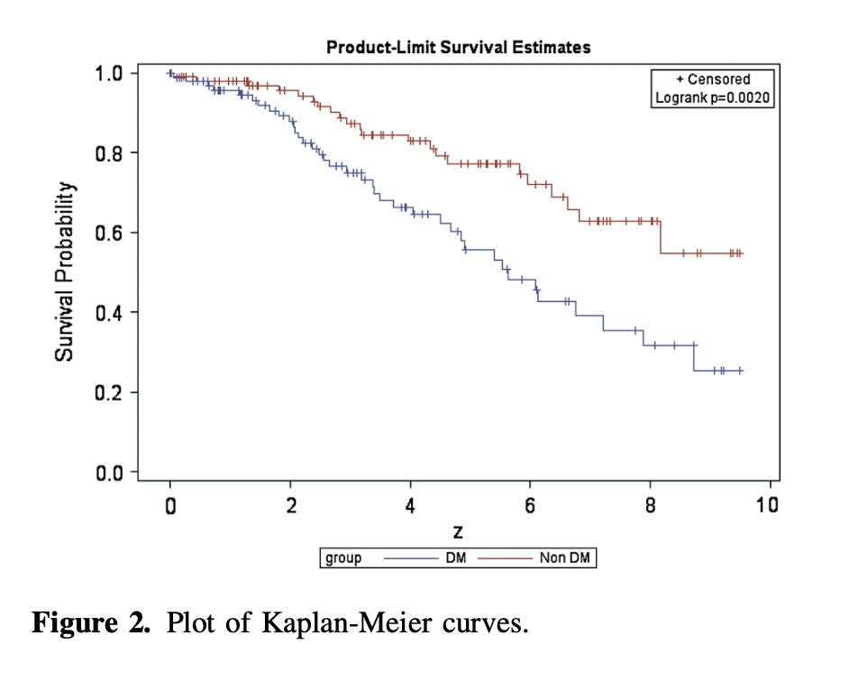
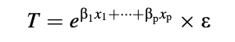
Survival Analysis
Time-to-event outcomes
Survival vs. hazard
Censored observation: event not observed during follow-up
Right, left, interval censoring
Life table
Kaplan-Meier estimation
Log-rank test
Cox regression: proportional hazards, no time-varying covariates/stratified, hazard ratio vs. 1
AFT: accelerated failure time, parametric distribution of the event times, time ratio vs. 1
Notes:
George B, Seals S, & Aban I. (2014). Survival analysis and regression models. J Nucl Cardiol, 21(4): 686-694.

Slide 16
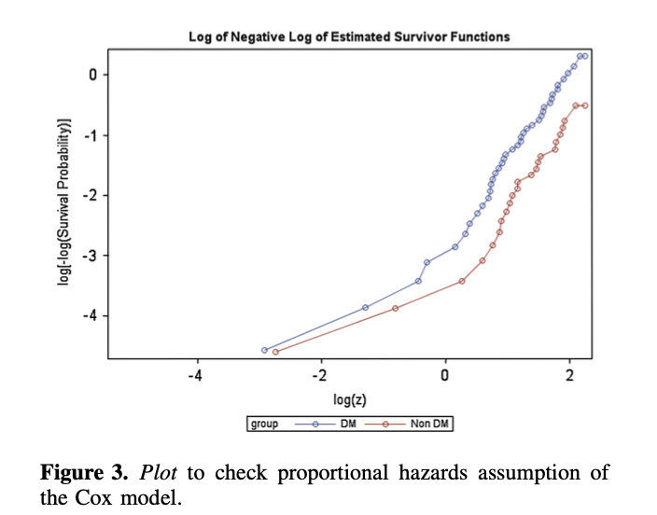
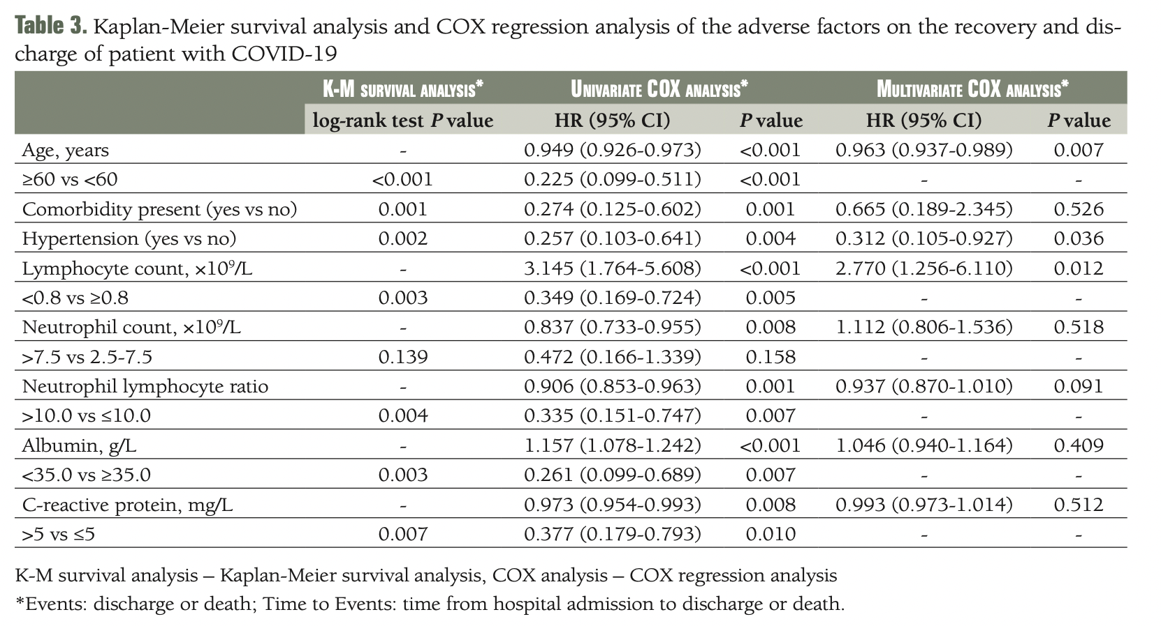
Cox regression
Notes:
George B, Seals S, & Aban I. (2014). Survival analysis and regression models. J Nucl Cardiol, 21(4): 686-694.
Hu H, Du H, Li J, Wang Y, Wu X, Wang C, Zhang Y, Zhang G, Zhao Y, Kang W, Lian J. Early prediction and identification for severe patients during the pandemic of COVID-19: A severe COVID-19 risk model constructed by multivariate logistic regression analysis. J Glob Health. 2020 Dec;10(2):020510. doi: 10.7189/jogh.10.020510. PMID: 33110593; PMCID: PMC7567445.

Slide 17
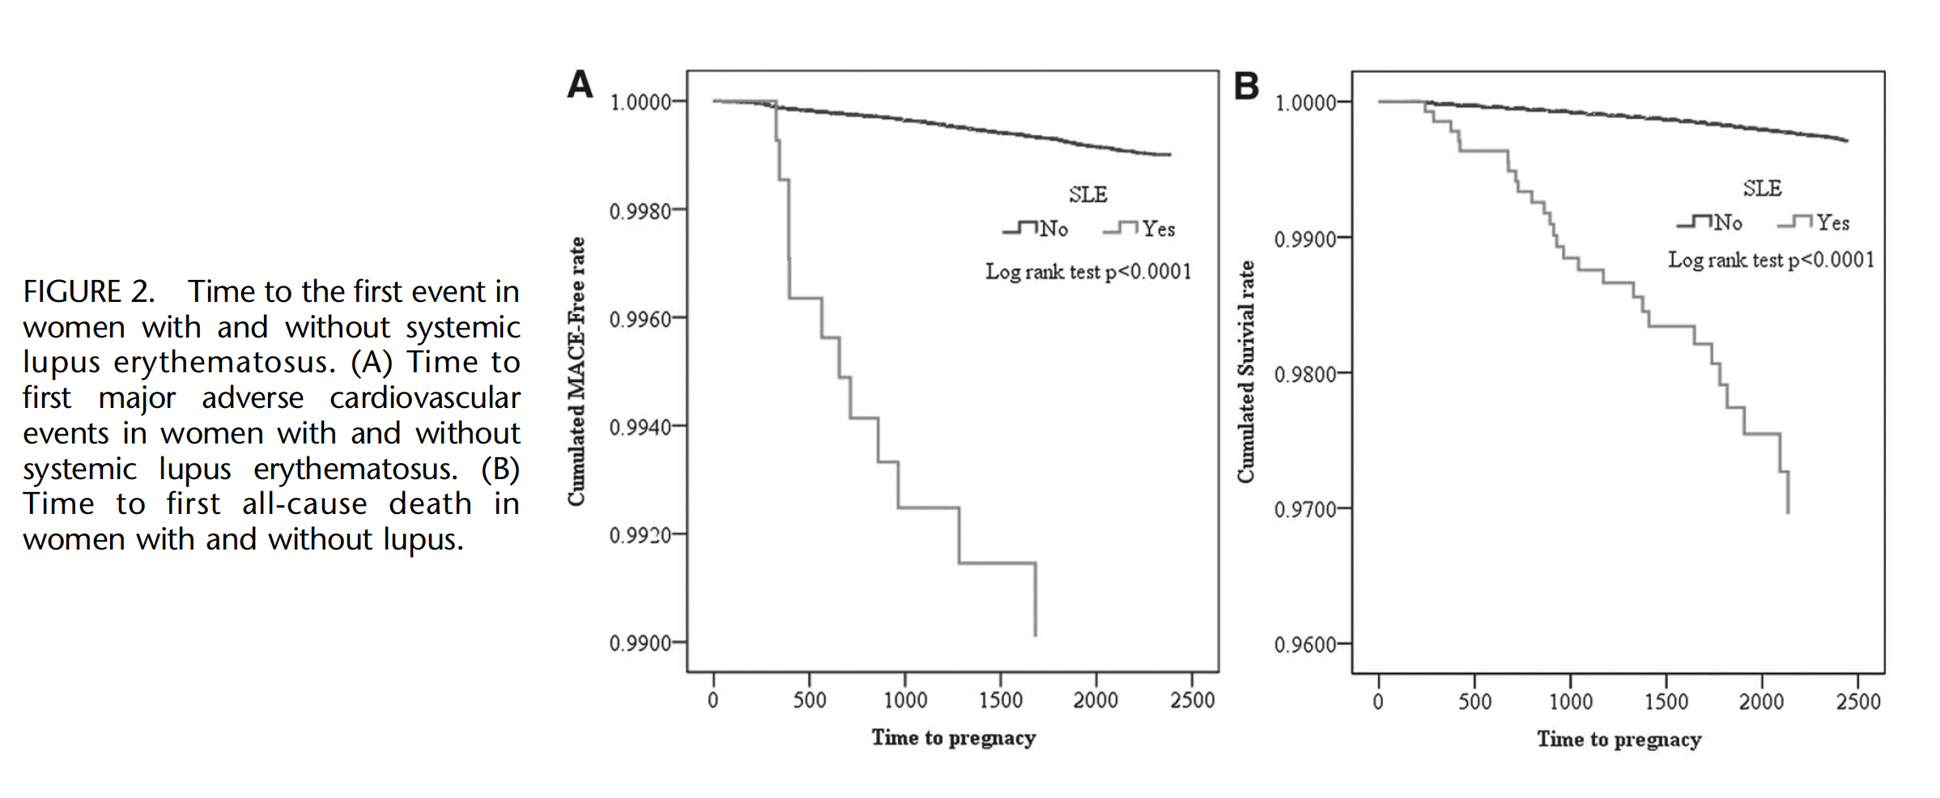
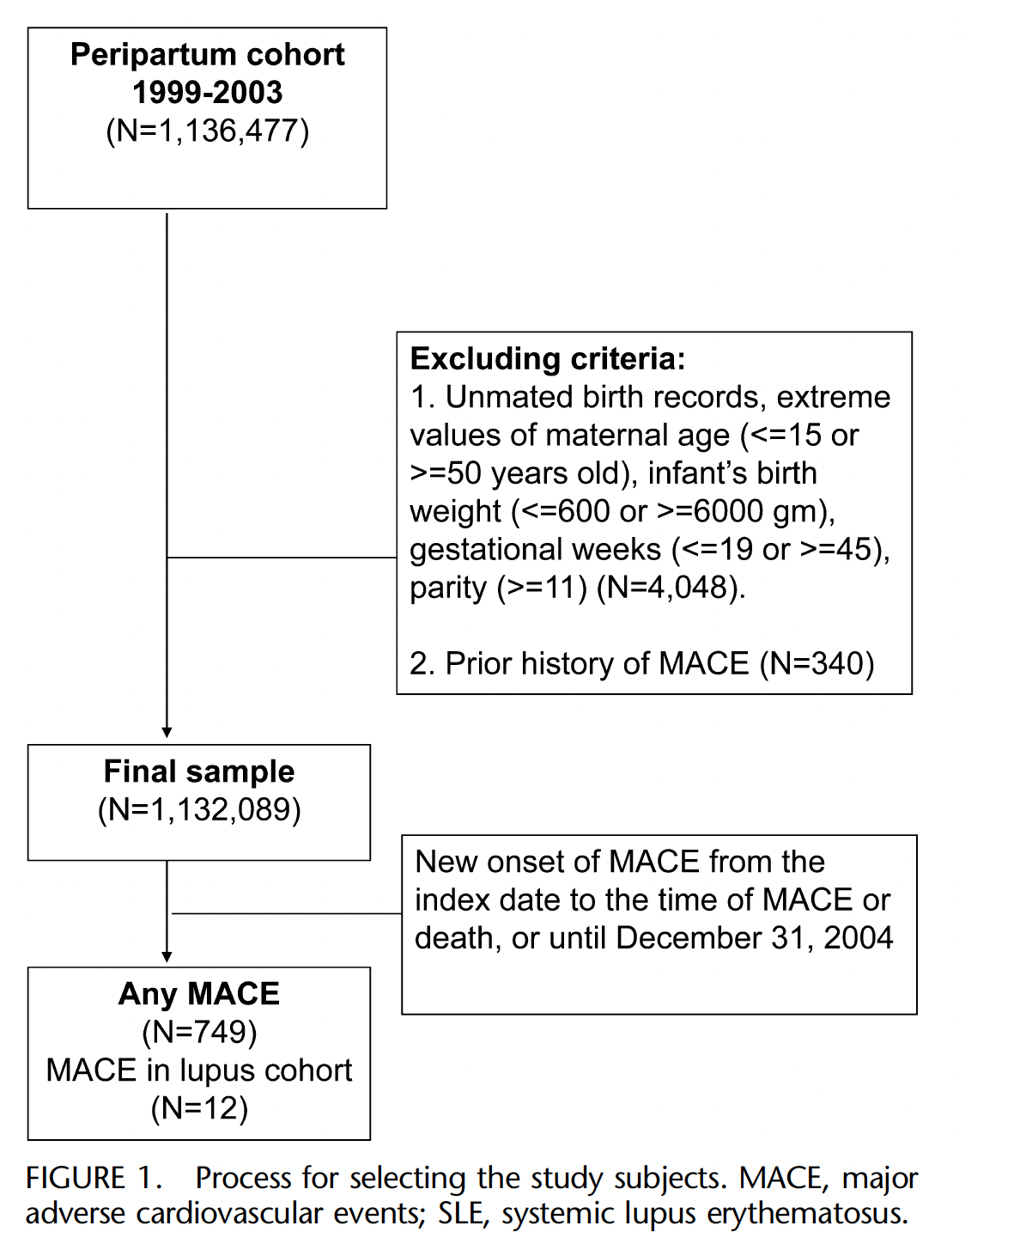
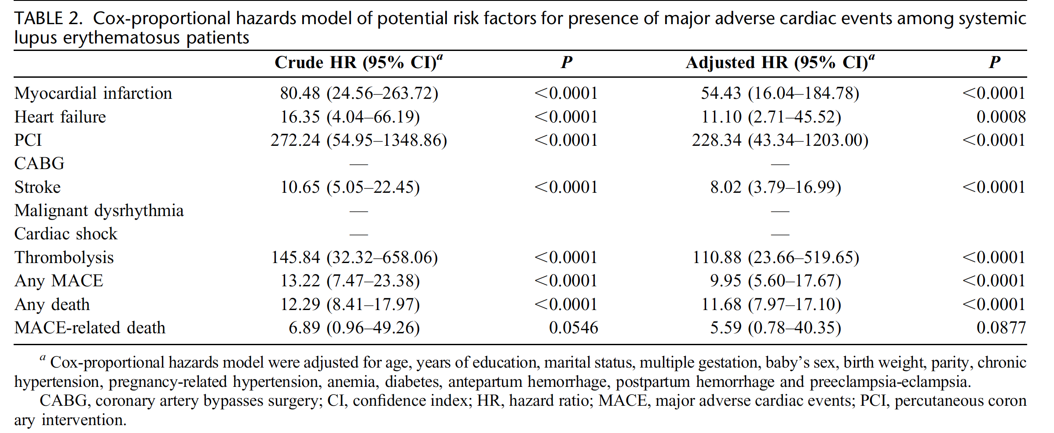
Major adverse cardiovascular events and mortality in SLE
Notes:
Wu LS, Tang CH, Lin YS, Lin CP, Hung ST, Hwa HL, Luo SF, Chu PH. Major adverse cardiovascular events and mortality in systemic lupus erythematosus patients after successful delivery: a population-based study. Am J Med Sci. 2014 Jan;347(1):42-9. doi: 10.1097/MAJ.0b013e318278707f. PMID: 23255242. https://pubmed.ncbi.nlm.nih.gov/23255242/

Slide 18
Lab session
Have fun! Interpretations?

Slide 19
Steps
Data Science: research question, dataset, potential analysis
Data Quality: background literature review, data collection
Data Cleaning: raw data, cleaned data
Data Analysis: assumptions, syntax, output, diagnostics
Results: table/figures
Discussion: interpretation, sample demographics, test p-value, effect size, sensitivity analysis etc.
19

Slide 20
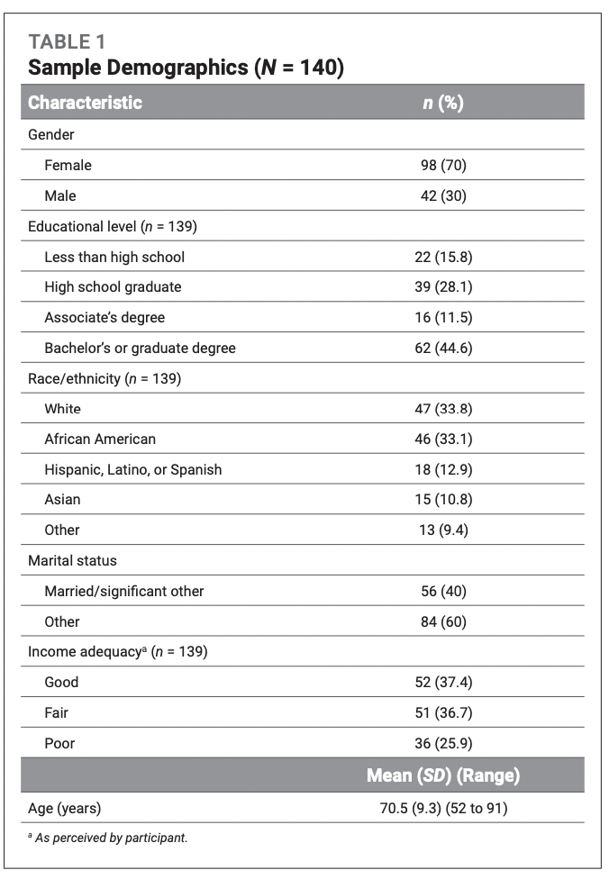
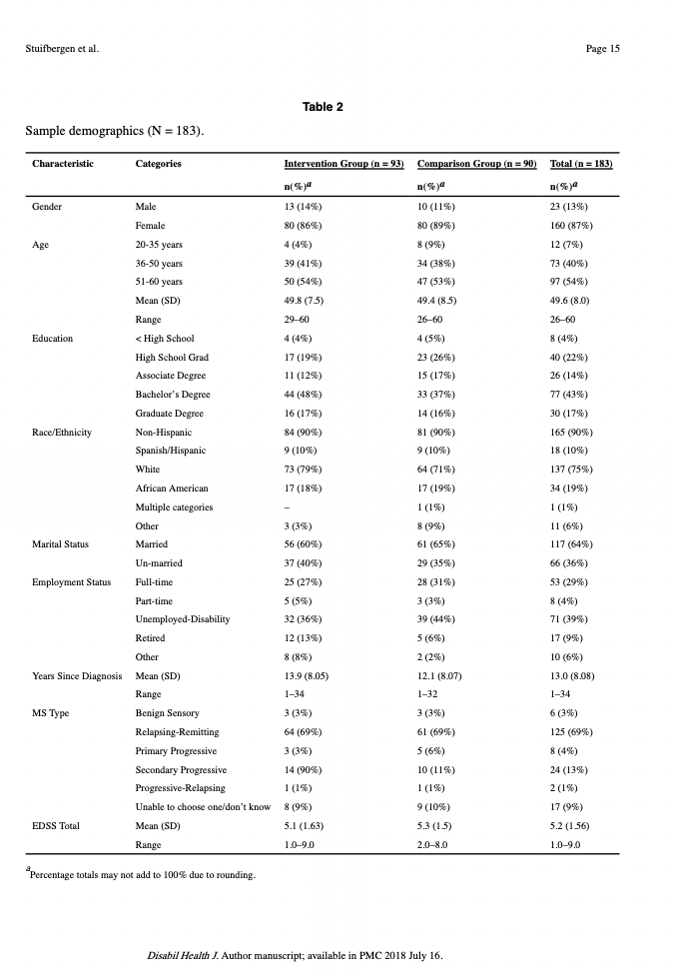
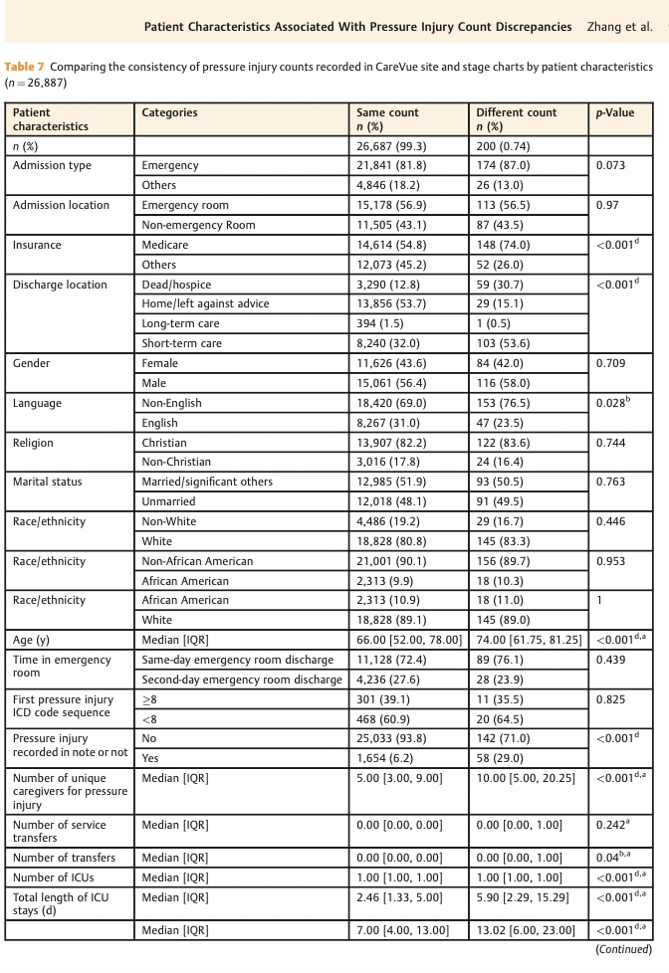
Sample demographic/characteristics
Notes:
Zhang W, Radhakrishnan K, Becker H, Acton GJ, Holahan CK. Self-Regulation Strategies as Predictors: Managing Multimorbidities Among Community-Dwelling People Aging with Arthritis. West J Nurs Res. 2020 Sep;42(9):698-707. doi: 10.1177/0193945919893679. Epub 2020 Jan 16. PMID: 31941422.
Zhang W, Sotoodeh M, Ho JC, Simpson RL, Hertzberg VS. Examining the Concordance in the Documented Pressure Injury Site, Stage, and Count in Medical Information Mart for Intensive Care-III. Appl Clin Inform. 2021 Aug;12(4):897-909. doi: 10.1055/s-0041-1735179. Epub 2021 Sep 29. PMID: 34587637; PMCID: PMC8481012.
Stuifbergen AK, Becker H, Perez F, Morrison J, Brown A, Kullberg V, Zhang W. Computer-assisted cognitive rehabilitation in persons with multiple sclerosis: Results of a multi-site randomized controlled trial with six month follow-up. Disabil Health J. 2018 Jul;11(3):427-434. doi: 10.1016/j.dhjo.2018.02.001. Epub 2018 Feb 16. PMID: 29477372; PMCID: PMC6047944.
R table 1 packages and examples:
Example links: https://cran.r-project.org/web/packages/table1/vignettes/table1-examples.html
https://cran.r-project.org/web/packages/tableone/vignettes/introduction.html
Explore more: Try to ask Chatgpt: what are the R packages to develop table 1? Then you could search for and read the package manuals and search for example codes.
Also, check the list of all R packages: https://cran.r-project.org/web/packages/available_packages_by_name.html

Slide 21
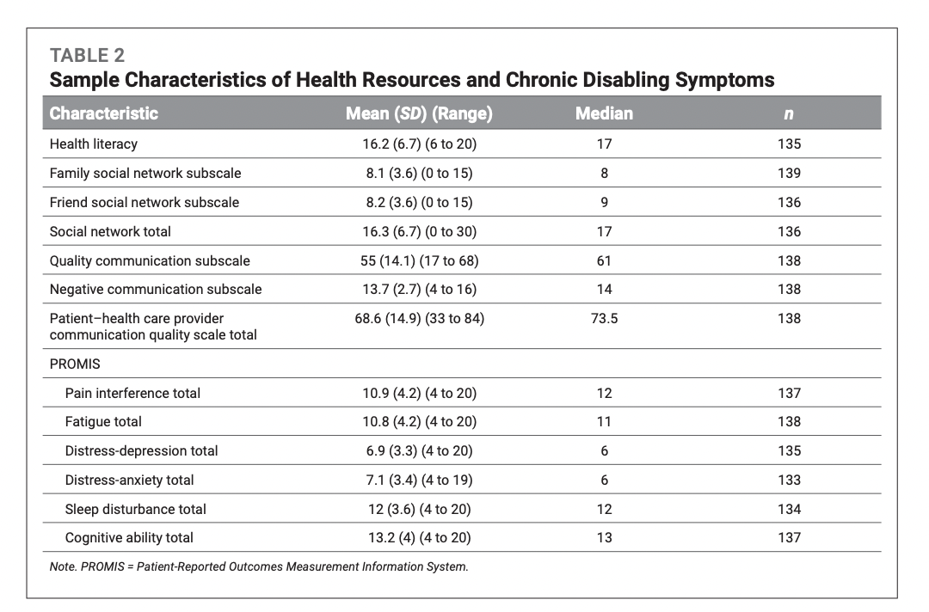
Sample demographic/characteristics
Notes:
Zhang W, Radhakrishnan K, Becker H, Acton GJ, Holahan CK. Self-Regulation Strategies Among Community-Dwelling People Aging With Arthritis and Multimorbidity. J Gerontol Nurs. 2021 Jan 1;47(1):35-45. doi: 10.3928/00989134-20201209-03. PMID: 33377983.

Slide 22
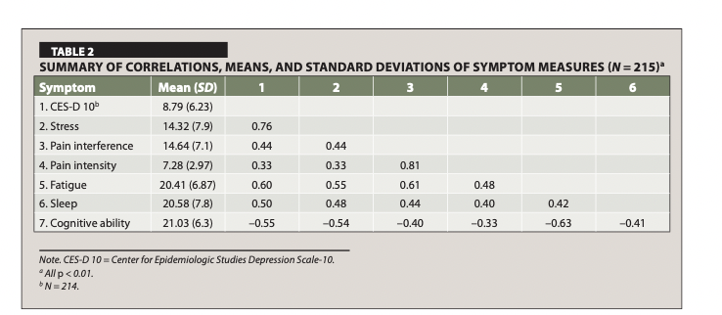
Correlation table
Notes:
Zhang W, Becker H, Stuifbergen AK, Brown A. Predicting Health Promotion and Quality of Life With Symptom Clusters and Social Supports Among Older Adults With Multiple Sclerosis. J Gerontol Nurs. 2017 Oct 1;43(10):27-36. doi: 10.3928/00989134-20170406-04. Epub 2017 Apr 11. Erratum in: J Gerontol Nurs. 2018 Jun 1;44(6):5. PMID: 28399316.

Slide 23
Statistical analysis and reporting: common errors
Intro: clear aim, PICOS, study needs
Methods: hypothesis, all outcome measures, inclusion/exclusion
Statistical methods
Appropriate statistical methods
Summary, assumption
Paired or cluster data
Diagnostic test: cut-off threshold
Reporting: sample size, multiple hypothesis testing
Results: effect size (CI)
Discussion: statistical and clinical significance, direction
Notes:
Worthy G. Statistical analysis and reporting: common errors found during peer review and how to avoid them. Swiss Med Wkly. 2015 Feb 4;145:w14076. doi: 10.4414/smw.2015.14076. PMID: 25650947. https://pubmed.ncbi.nlm.nih.gov/25650947/

Slide 24
Annotated outputs
https://stats.oarc.ucla.edu/other/annotatedoutput/
Directed acyclic graphs?
https://www.dagitty.net/dags.html

Slide 25
Questions? Thank you!

